Slide 1


INSTALLING INTERNET INFORMATION SERVICES
(20IT4607-ETHICAL HACKING PROJECT)
MD ZUBAIR(208W1A1233)
M.SATHVIK (208W1A1234)
N.SUSHMA (208W1A1235)
T.NIKITHA (208W1A1236)

Slide 2
PROBLEM STATEMENT
To create a website :
Install Internet Information Services(IIS) on your computer.
Check if it is installed correctly or not using your web browser.

Slide 3
INTRODUCTION
DEFINITION: Internet Information Services (IIS) is a flexible, general-purpose web server from Microsoft that runs on Windows system to serve requested HTML pages or files.
An IIS web server accepts request from remote client computers and return the appropriate response. The basic functionality allow web servers to share and deliver information across local area networks(LAN) such as corporate intranets and wide area networks(WAN) such as the Internet.

Slide 4
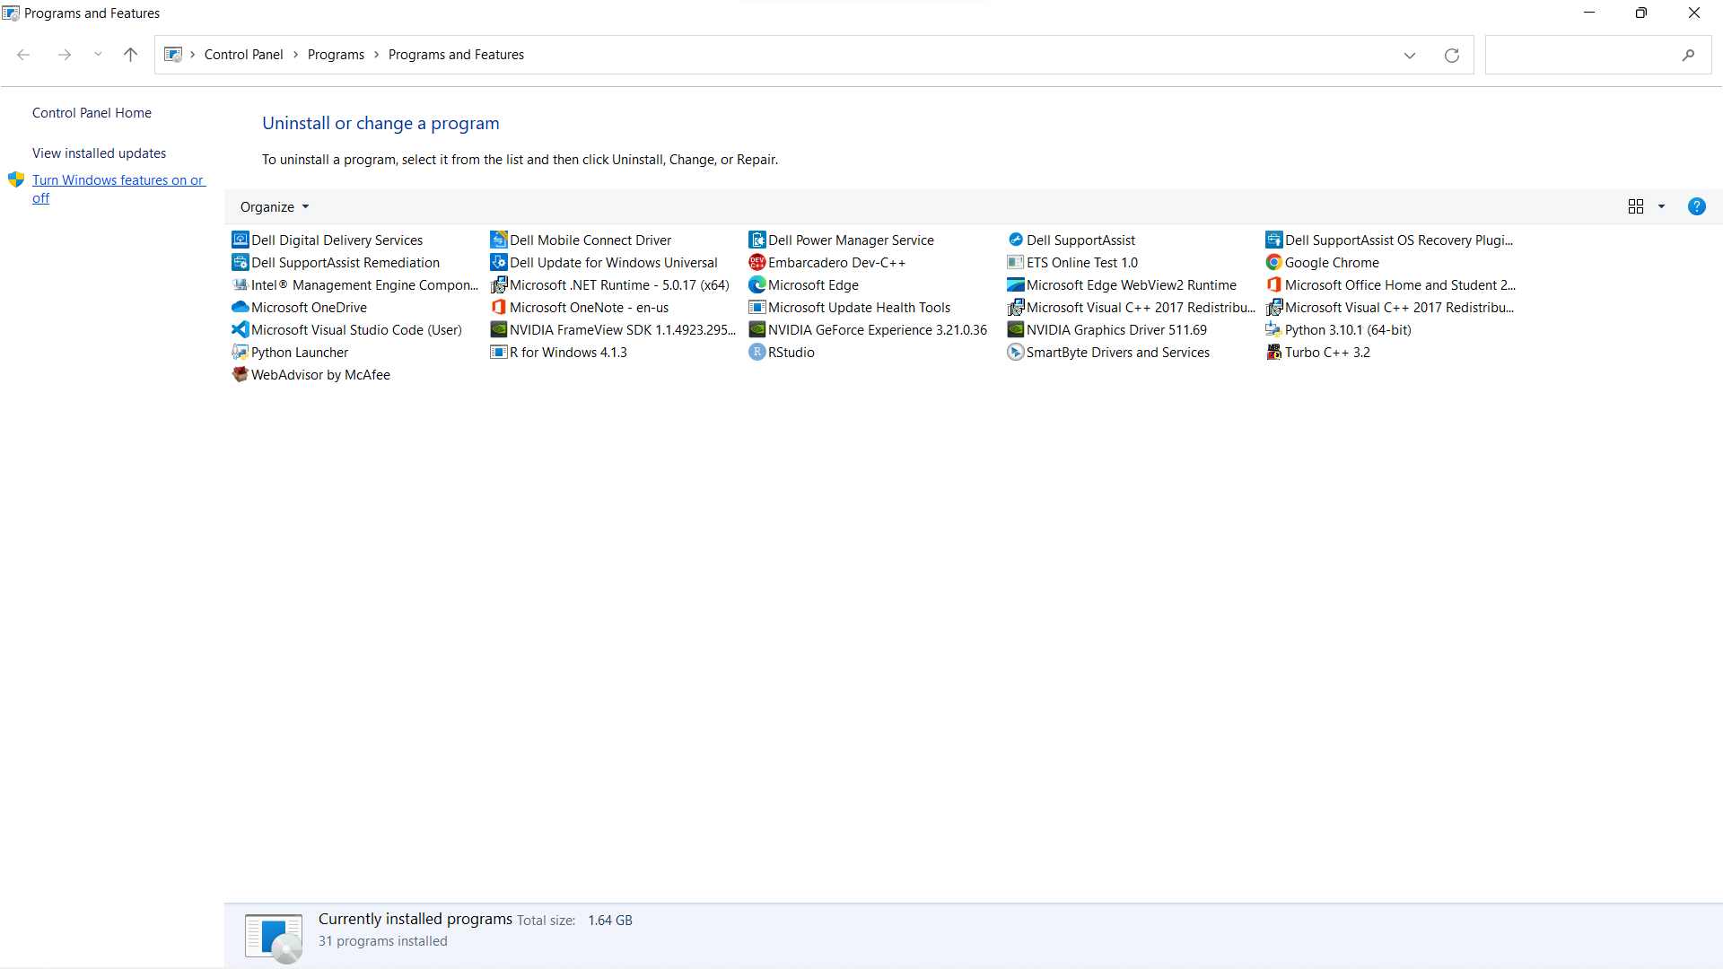
INSTALLING INTERNET INFORMATION SERVICES
Step 1:
Search appwiz.cpl and click Turn Windows features on or off.

Slide 5
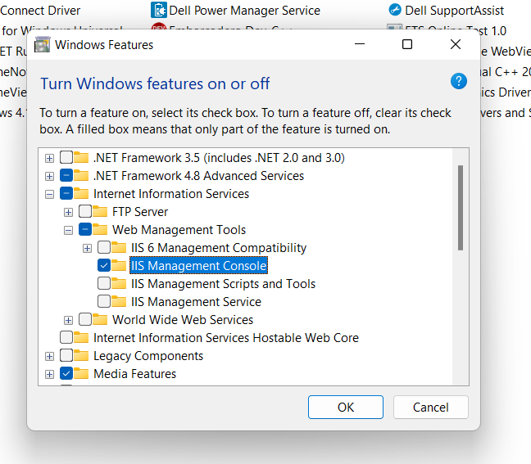
Step 2:
Enable Internet Information Services.
Then enable Web Management tools.
Select IIS Management Console.

Slide 6
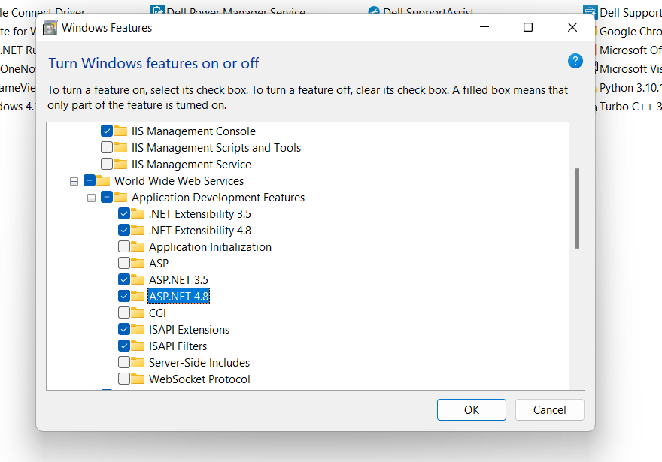
Step 3:
Enable World Wide Web Services by selecting:
.NET Extensibility 3.5
.NET Extensibility 4.8
ASP.NET 3.5
ASP.NET 4.8
from Application Development Features.

Slide 7
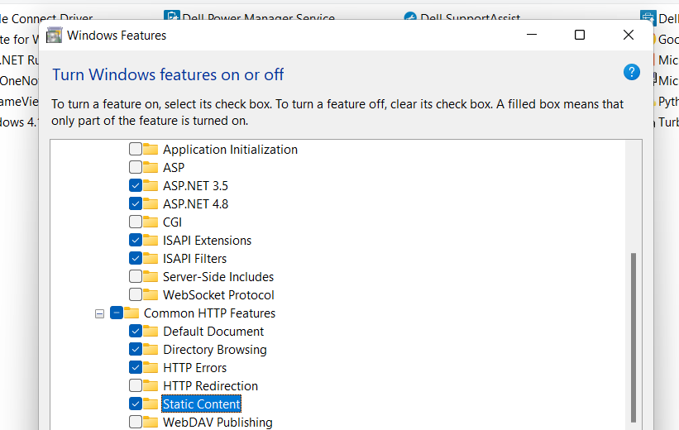
Step 4:
Select
Default Document
Directory Browsing
HTTP Errors
Static Content from Common HTTP Features.

Slide 8
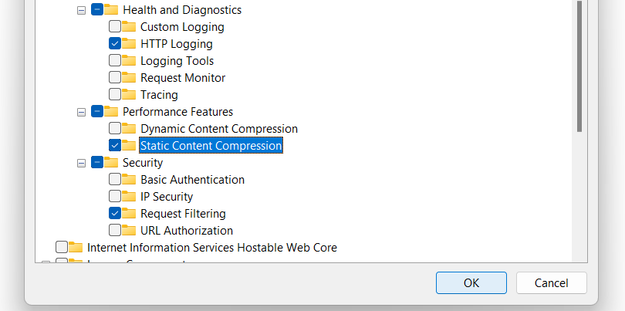
Step 5:
Click HTTP Logging from Health and Diagnostics.
Select Static Content Compression from Performance Features.
Add Request Filtering from Security.
Now click on OK.

Slide 9
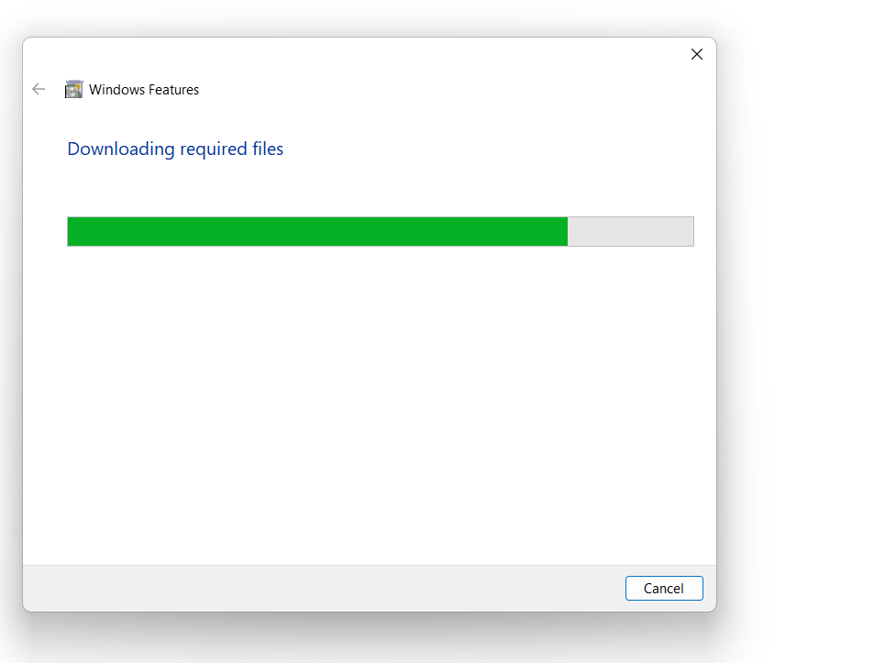
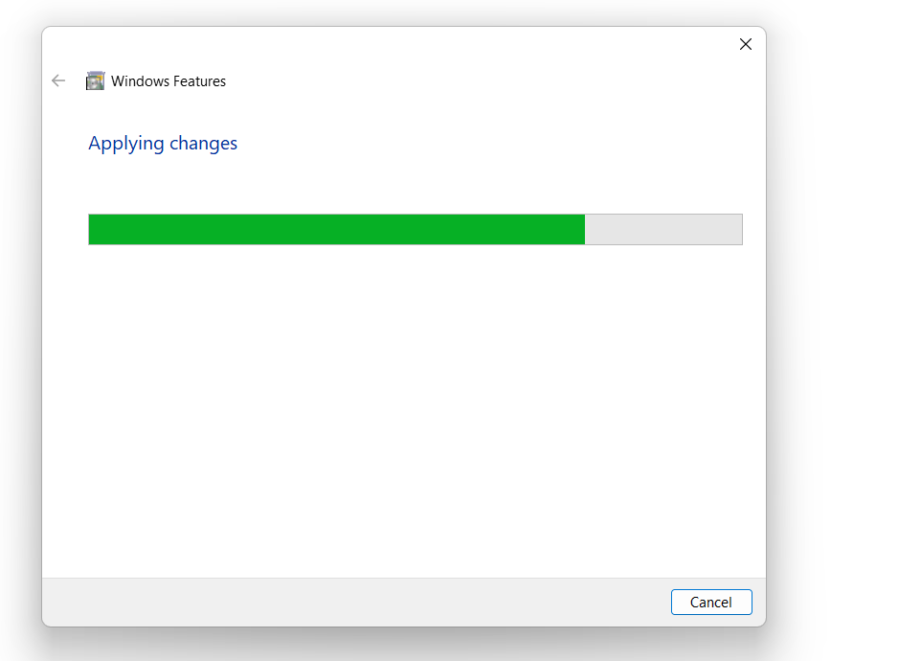
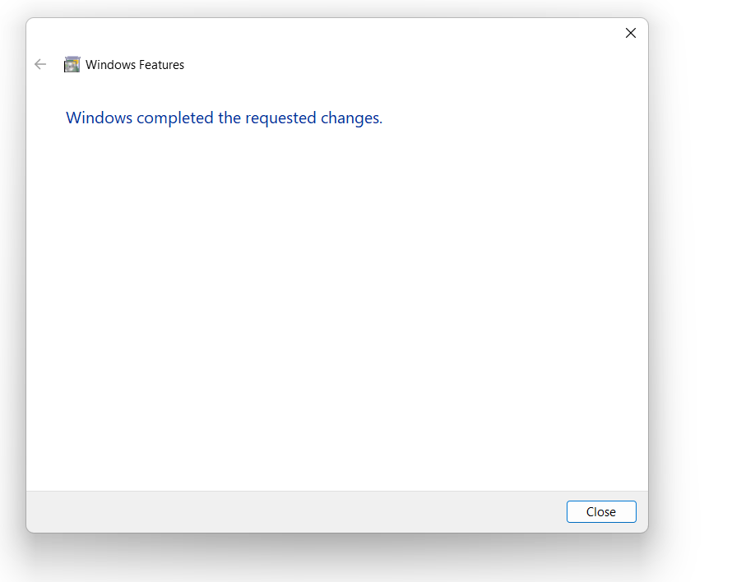
After clicking on OK , required files will be searched and downloaded.
Requested changes will be applied.
Installation is done.

Slide 10
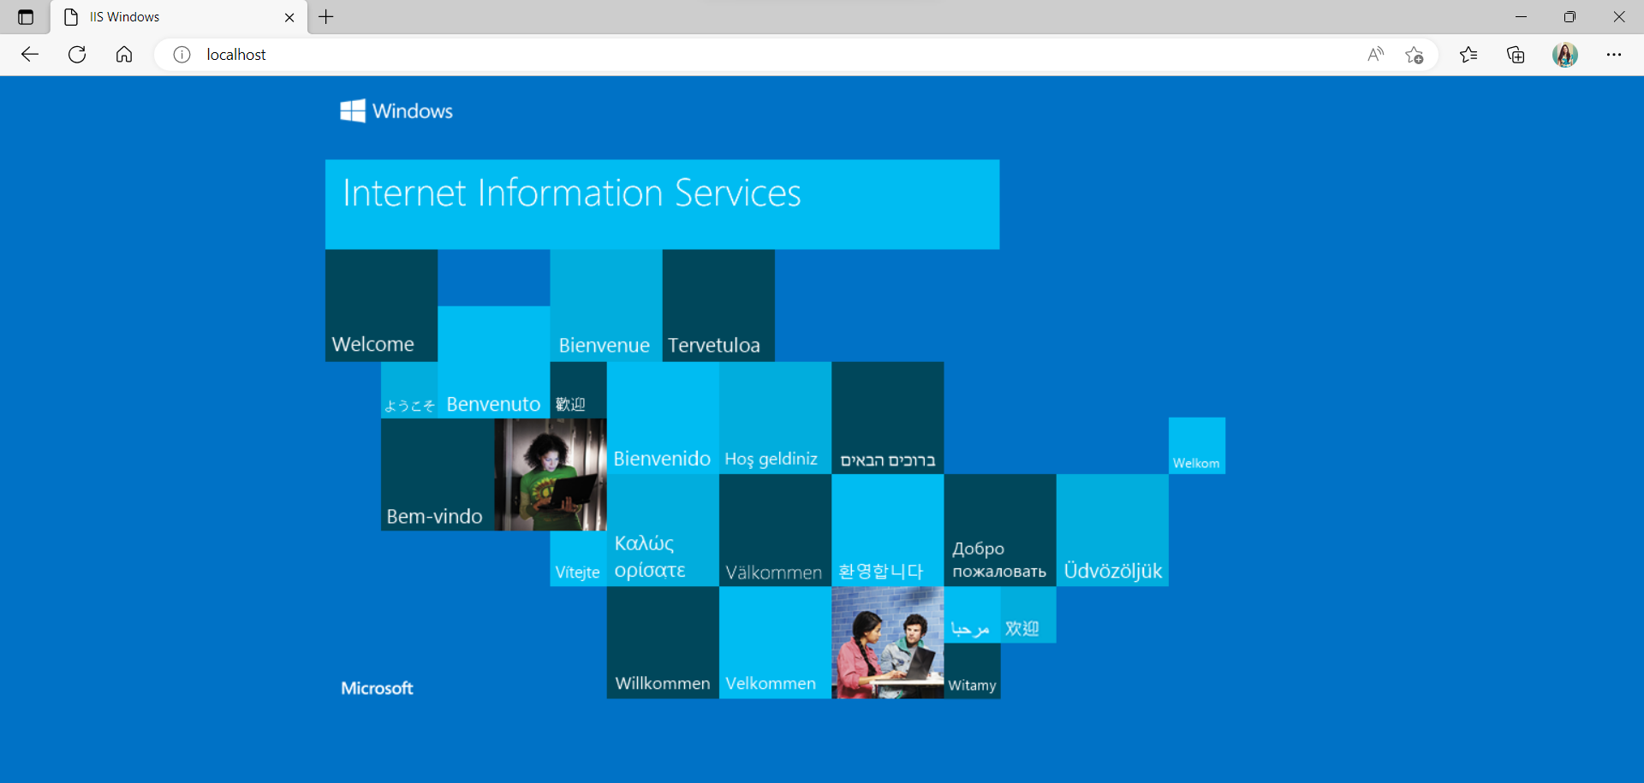
Step 6:
To check if IIS is installed correctly or not ,open Microsoft Edge and type localhost. The following page will be displayed as a result of successful installation of Internet Information Services.

Slide 11
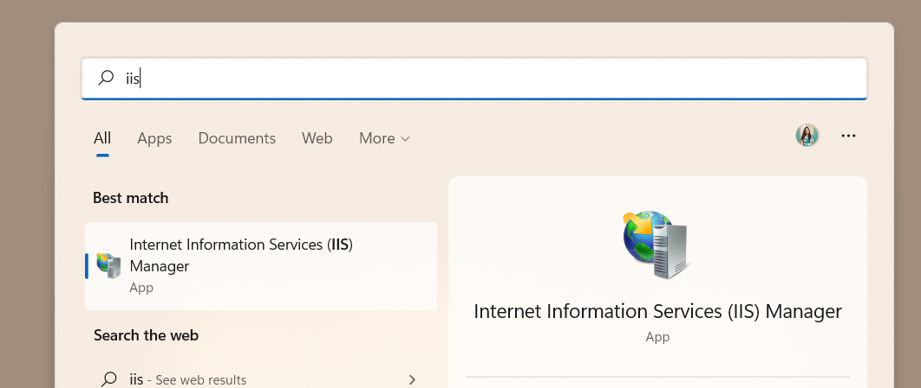
Creating a Website using IIS
Step 1:
Open IIS Manager.
Open Internet Information Services(IIS) Manager. You can find it quickly by typing “IIS” in the search filed.

Slide 12
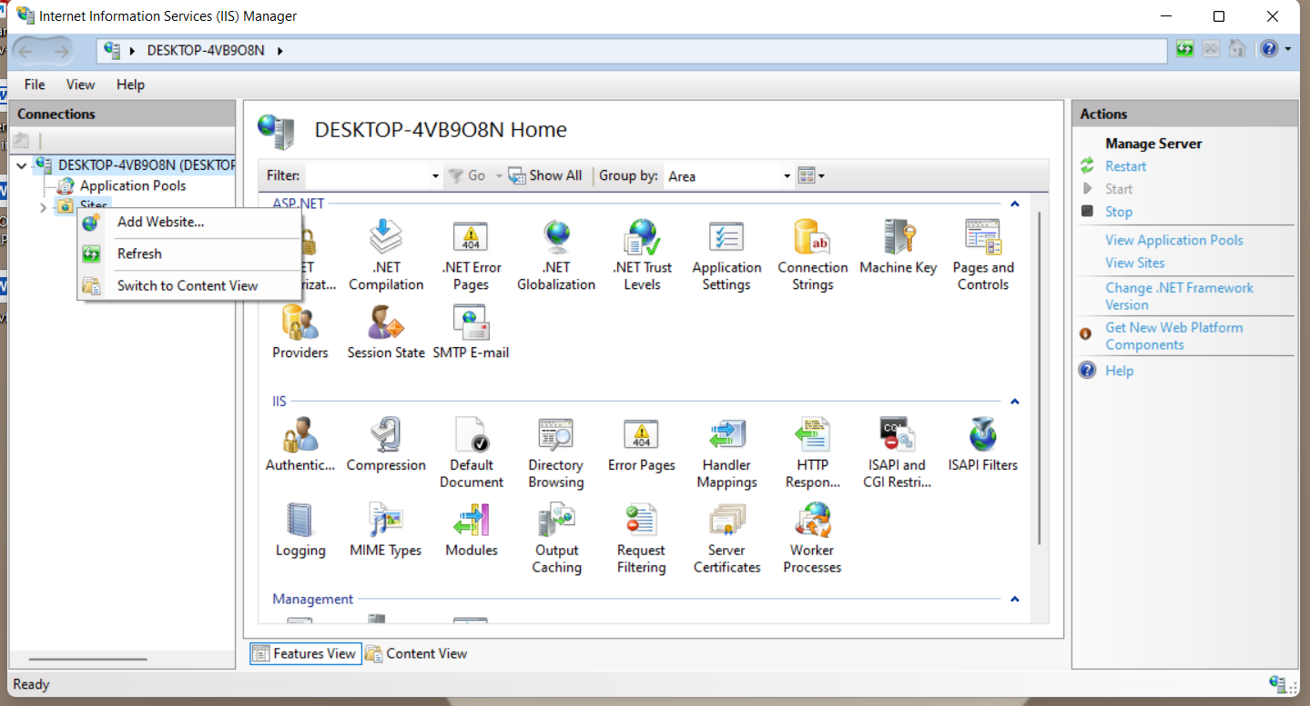
Step 2:
Add website.
Expand your computer’s directory by clicking the > to the left of the icon in the left-hand pane. Then, right-click Sites and select Add Website…

Slide 13
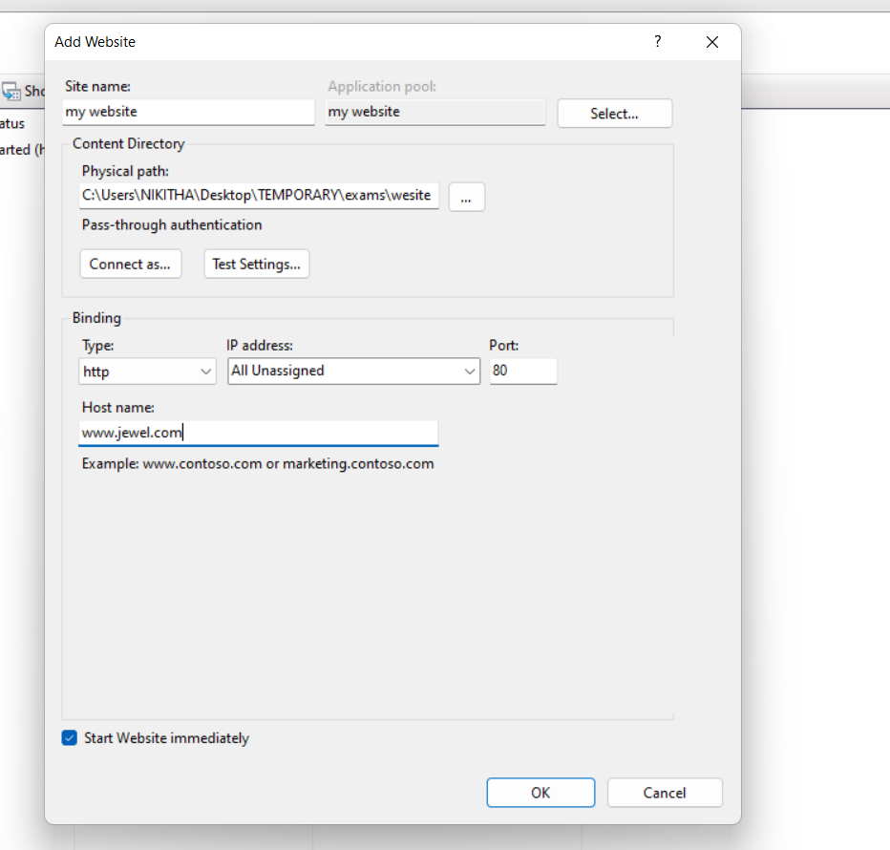
Step 3:
Create site name.
The Add Website window will open. First, add a name for the website in the Site name field.
(here my website)
Step 4:
Add physical path.
Navigate to the directory containing your website’s files so that it appears in the Physical path field.

Slide 14
Step 5:
Set binding options.
Under Binding, select the Type(HTTP or HTTPS), IP address, Port and Host name.
Step 6:
Decide whether to start or not the website.
If you would like to start the website right away, make sure that Start Website immediately is checked. If not, uncheck it.

Slide 15
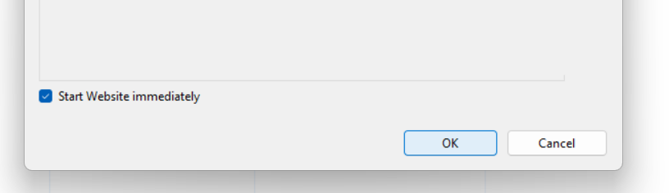
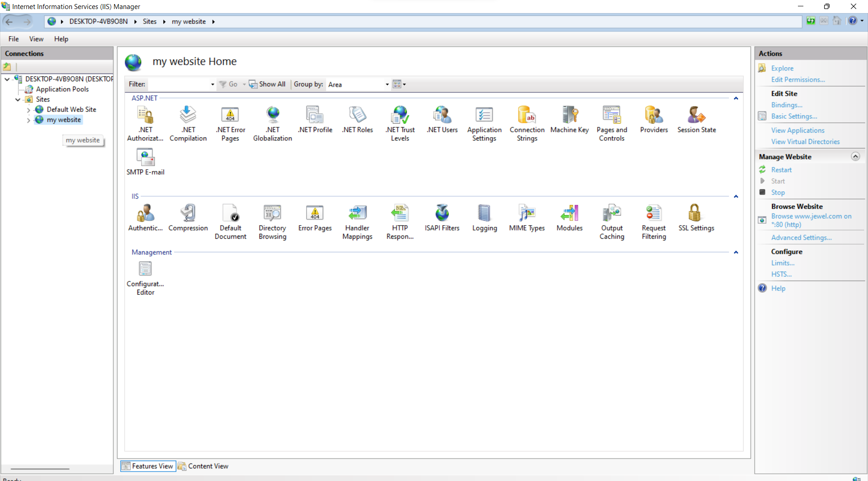
Step 7:
Finish up.
Click the OK button to finish creating your new website.
After the Add Website window closes, you will see your new website in the list of site.
(here my website)

Slide 16
*** THE END ***

